Slide 1
Test Execution Technique
Test Execution Types - Regression Testing
LEVEL – LEARNER

Slide 2
Charanya Muralidaran (426978), Chandraprabu D (273372)
Charanya: 4+ years of experience in Data Warehousing domain, Chandraprabu: 9+ years of experience in IT industry with DW domain
V1.0 3/23/2015

Slide 3







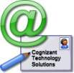

Icons Used
Hands-on Exercise
Questions
Tools
Coding Standards
Test Your Understanding
Reference
A Welcome Break
Demonstration
Contacts

Slide 4
Regression Testing: Objective
After completing this chapter, you will be able to learn:
Execution of workflows or job to check the change in code has not impacted the existing functionalities.
New code change impact on the existing functionalities.
Identification of regression test cases and execution.
Risk-based testing.
Performance of ETL job after code change validation.
To check for restarting of jobs in case of failures.
Automation of regression suite using Platinum.

Slide 5
Regression Testing: Overview
The purpose of regression testing is to confirm that a recent program or code change has not adversely affected existing features. It also ensures that old code still works once the new code changes are done.

Slide 6
Introduction
The purpose of Regression Testing is to confirm that a recent program or code change has not adversely affected existing features.
It also ensures that old code still works once the new code changes are done.
Need of Regression Testing:
In ETL, Regression Testing is required when there is a change in requirements and code is modified according to the requirement and new feature is added to the software.
Defect fixing.
Performance issue fixes.
This test can be performed on a new build when there is significant change in database in original functionality or even a single bug fix.
Regression Testing Best Practices:
Run the automated test cases based on impacted functionalities (using Platinum or execution scripts).
Prioritize the test cases depending on business impact, critical, and frequently used functionalities.
Selection of test cases in ETL testing based on priority will greatly reduce the regression test suite.

Slide 7
Regression Testing Criteria
Entry Criteria:
Regression Test Scripts are ready.
All entry criteria for system testing have been met.
Security Key/Configuration keys are finalized.
Performance SLA such as job run time and data load time has been defined for the code changed functionalities.
Regression test bed is available.
Consistency Verification Test Script is ready.
Exit criteria:
All “Fix before breathing” and “Fix immediately” priority bugs in ETL are fixed and fix is verified.
High priority bugs are fixed and verified.
If any medium or low-priority errors are outstanding, the implementation risk must be conditionally signed off as acceptable by Business Analyst and/or Client.
No open Issues/Queries exist.

Slide 8
Regression Test Case Selection in DWBI
There are three major areas to be looked into before creating an ETL regression test suite:
Risk-based testing
Specification-based test case selection
Defects area of influence

Slide 9
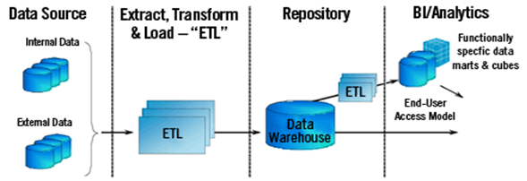
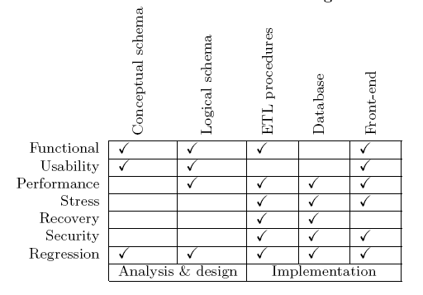
DWBI Flow
A typical DW/BI project can be viewed as comprising two broad components.
Constructing the DW using extract, transform, and load (ETL) technologies and presenting of the same for analysis purposes with online analytical processing (OLAP) technologies.

Slide 10
Risk-Based Testing
Risk-based testing is highly related to the concept of good enough testing.
It is a good framework for the decision-making in projects where risks are being taken, especially during the release. The definition of “good enough” in the context of a system (or increment/enhancement) to be released is:
It has sufficient benefits.
It has no critical problems.
It’s benefits sufficiently outweigh its non-critical problems.

Slide 11
Risk-Based Testing
Risk-Based Testing Implementation in Project:
Identify all the critical factors/parameters applicable to the Project.
Evaluate the factors affecting the project.
Categorize Risks on 1 – 5 Scale (1 Low, 5 High).
Failure of a risk 5 test case would mean the system is not acceptable.
Resolve Risk 1 test case which is a problem and is likely to inconvenience the user.
Plot the requirements and find the probability of failure of each function against each factor.
Create a report that gives test case distribution by risk category. This helps to analyze that the testing is focused on high-risk areas.
Key Benefits:
Improves detection of critical defects.
Reduces test effort by focusing and prioritizing test case execution with higher risk.
Enables better risk-informed decision-making.
Reduces the need for a full regression testing through pre-calculated risk analysis.

Slide 12
Test Your Understanding
Answer the following questions based on your understanding of this chapter:
What are the entry criteria for Regression Testing?
What are the exit criteria for Regression Testing?
What is Risk-Based Testing?
What are the key benefits of Risk-Based Testing?

Slide 13
Summary
In this chapter, you should have learned:
The purpose of Regression Testing is to confirm that a recent program or code change has not adversely affected existing features.
It also ensures that old code still works once the new code changes are done.
There are three major areas to be looked into before creating an ETL regression test suite:
Risk-based testing
Specification-based test case selection
Defects area of influence
Risk-based testing is highly related to the concept of good enough testing.
Key benefits include:
Improves detection of critical defects.
Reduces test effort by focusing and prioritizing test case execution with higher risk.
Enables better risk-informed decision-making.
Reduces the need for a full Regression Testing through pre-calculated risk analysis.

Slide 14
Source
A Study of Effective Regression Testing in Practice: White Paper
Regression Testing - Test Management: White Paper
MSDN link for Regression Testing
en.wikipedia.org/wiki/Regression_testing
Disclaimer: Parts of the content of this course is based on the materials available from the Web sites and books listed above. The materials that can be accessed from linked sites are not maintained by Cognizant Academy and we are not responsible for the contents thereof. All trademarks, service marks, and trade names in this course are the marks of the respective owner(s).

Slide 15
You have successfully completed Regression Testing

